Slide 1
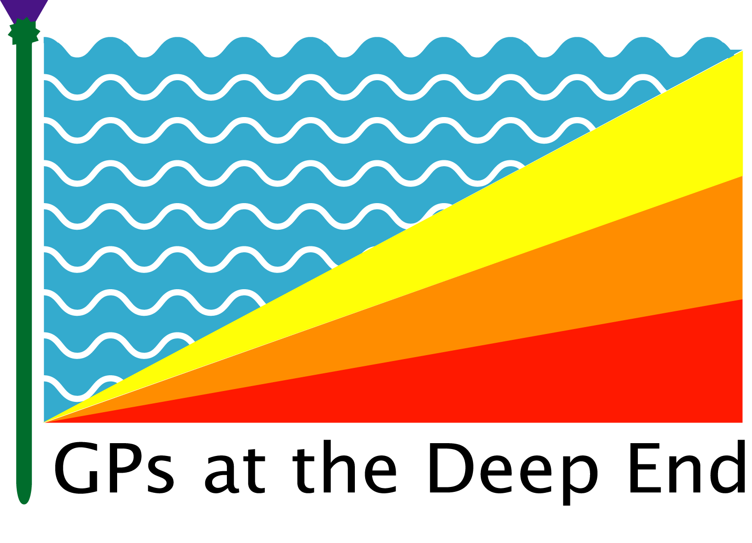
LEARNING FROM THE
SCOTTISH DEEP END PROJECT

Slide 2
% Differences from least deprived decile
for mortality, comorbidity, consultations and funding
British Journal of General Practice 2015:doi:10.3399/bjgp15X687829

Slide 3
CONSULTATIONS IN DEPRIVED AREAS
Multiple morbidity and social complexity
Shortage of time
Reduced expectations
Lower enablement (especially for mental health problems)
Poorer outcomes after 12 months
Higher practitioner stress
Mercer SM, Watt GCMW : clinical primary care encounters in deprived and affluent areas of Scotland
Annals of Family Medicine 2007;5:503-510

Slide 4
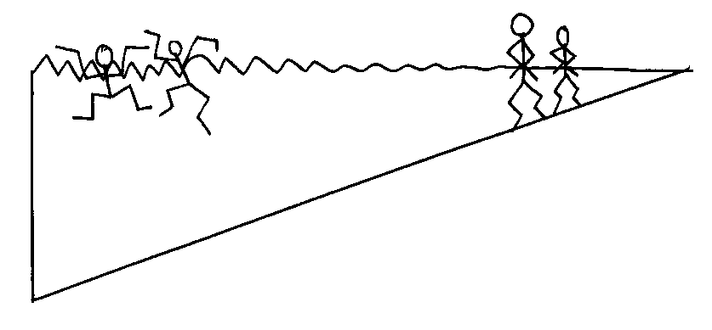
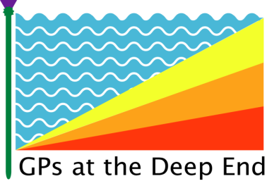
GENERAL PRACTITIONERS AT THE DEEP END
Notes:
4

Slide 6

SCOTLAND
IRELAND
YORKSHIRE
GREATER MANCHESTER
CANBERRA
PLYMOUTH
NORTH-EAST AND NORTH CUMBRIA
NOTTINGHAMSHIRE
NW LONDON

Slide 7
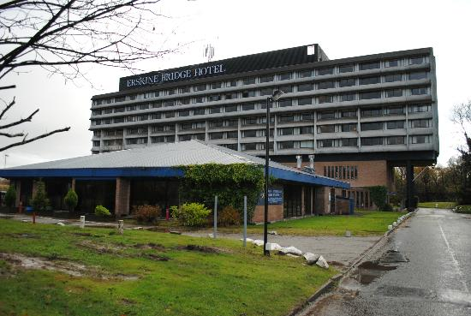
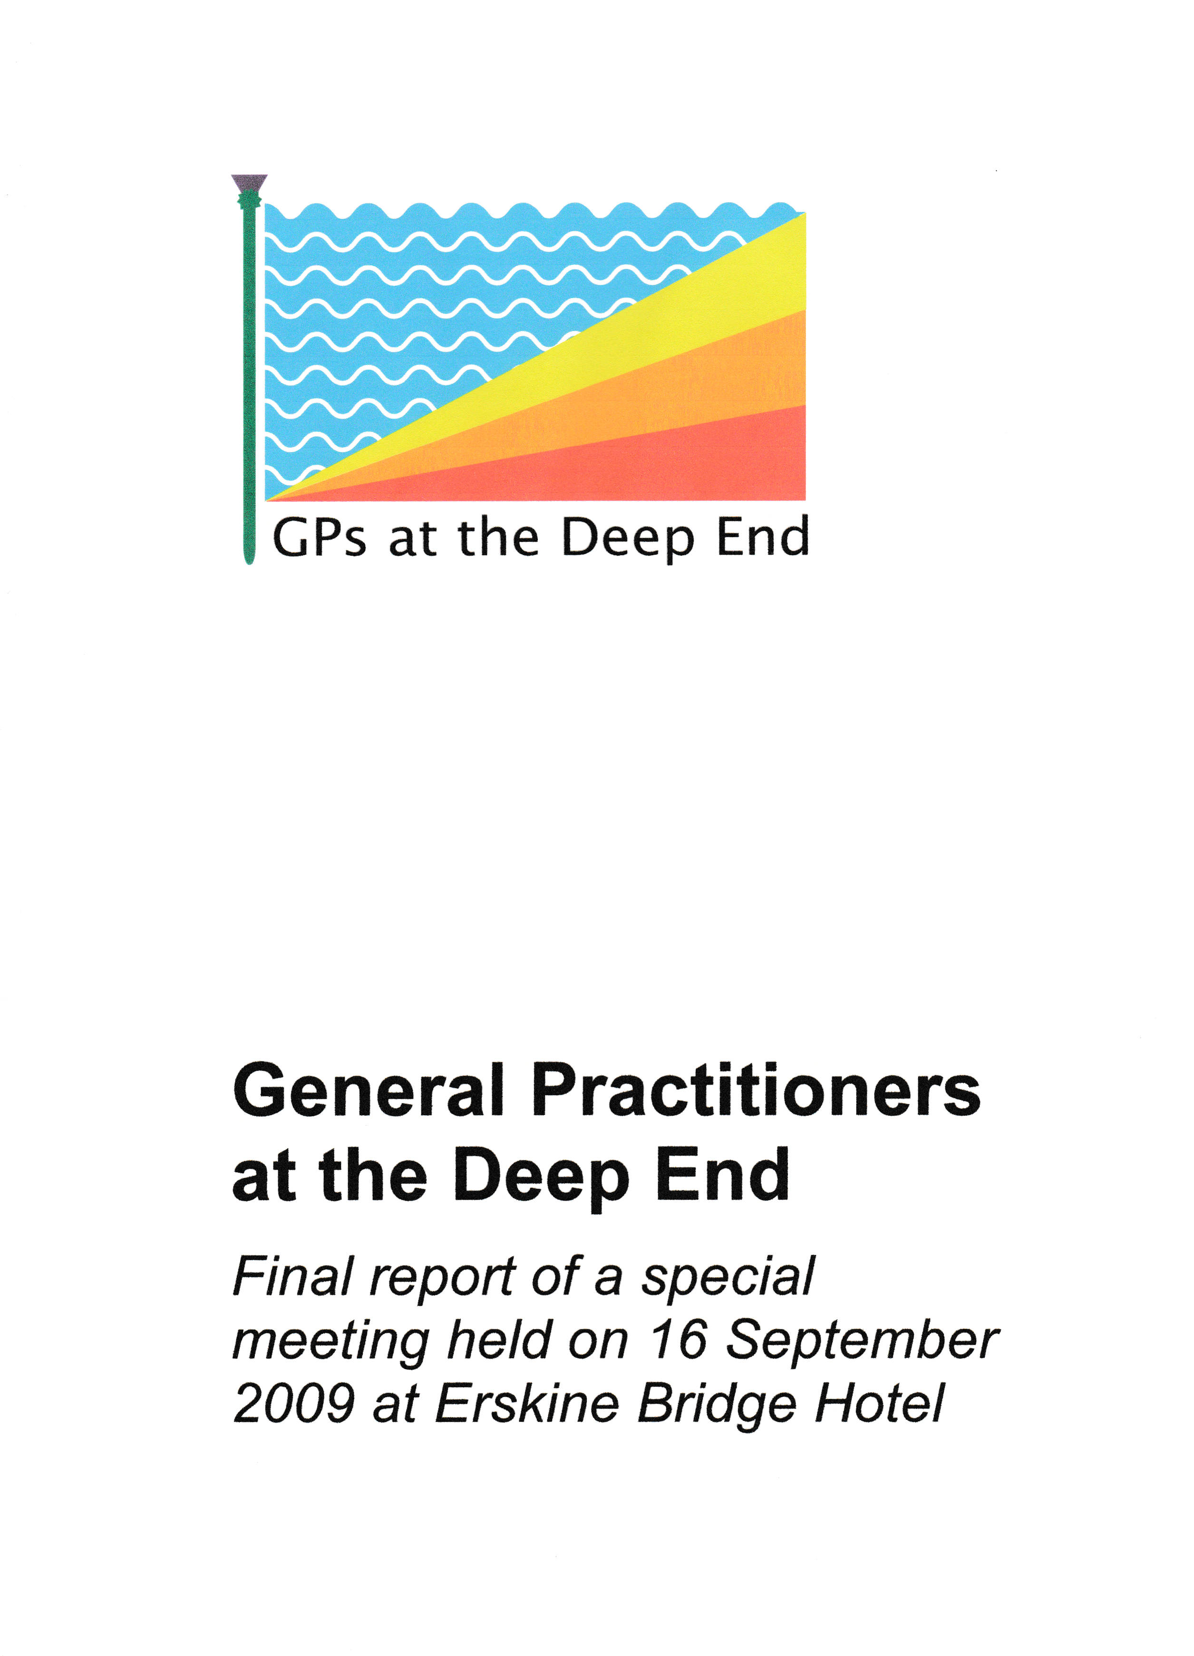
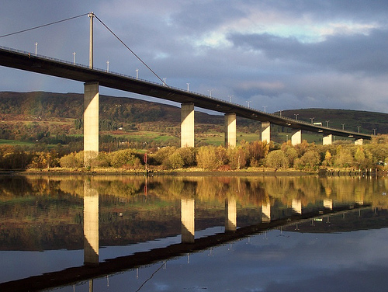

Slide 8

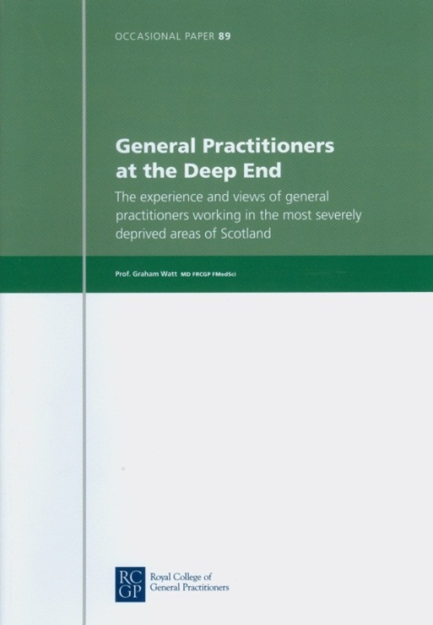
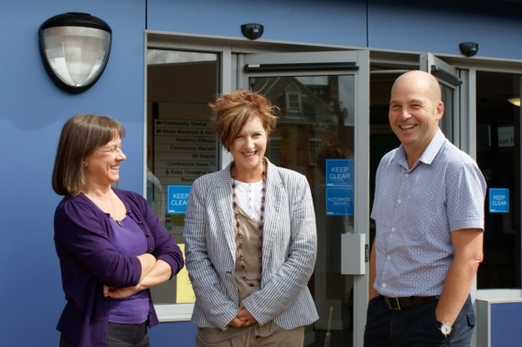
36 DEEP END REPORTS (www.gla.ac.uk/deepend)
First meeting at Erskine
Needs, demands and resources
Vulnerable families
Keep Well and ASSIGN
Single-handed practice
Patient encounters
GP training
Social prescribing
Learning Journey
Care of the elderly
Alcohol problems in young adults
Caring for vulnerable children and families
The Access Toolkit : views of Deep End GPs
Reviewing progress in 2010 and plans for 2011
Palliative care in the Deep End
Austerity Report
Detecting cancer early
Integrated care
Access to specialists
What can NHS Scotland do to prevent and reduce heath inequalities
GP experience of welfare reform in very deprived areas
Mental health issues in the Deep End
The contribution of general practice to improving the health of vulnerable children and families
What are the CPD needs of GPs working in Deep End practices?
Strengthening primary care partnership responses to the welfare reforms
Generalist and specialist views of mental health issues in very deprived areas
lmproving partnership working between general practices and financial advice services in Glasgow : one year on
GP recruitment and retention in deprived areas
GP use of additional time as part of the SHIP project
A role for members of the Scottish parliament in addressing inequalities in health care in Scotland
Attached Alcohol Nurse Deep End Pilot
8 years of the Deep End Project
Increasing undergraduate education in primary care in areas of socio-economic deprivation
The Deep End Project for 2019-22
Plans for advocacy and engagement by the Scottish Deep End Project
General practice in the time of COVID-19

Slide 9
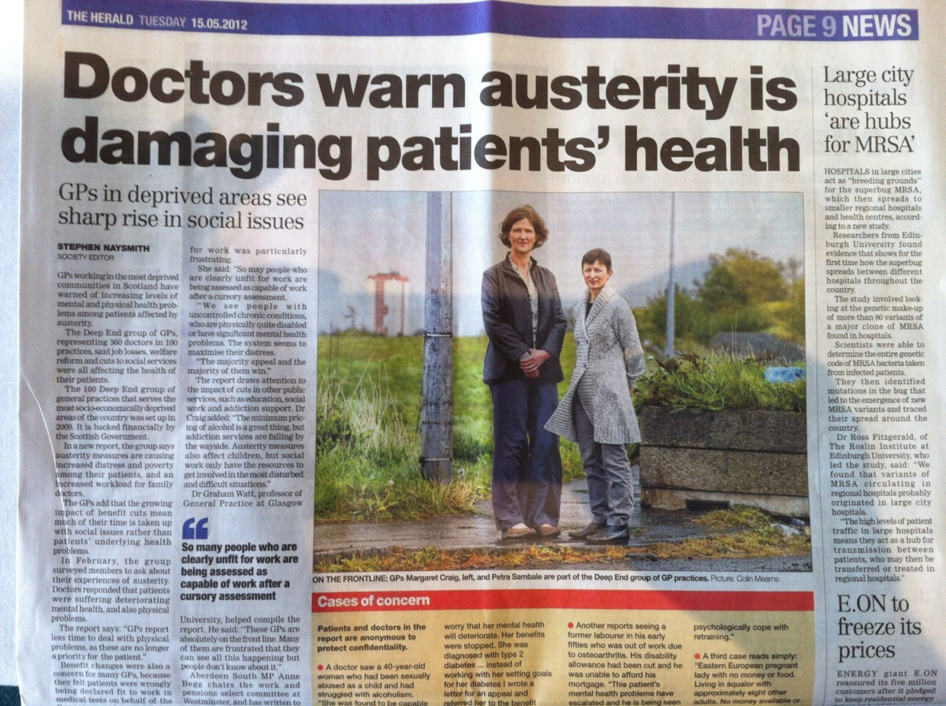
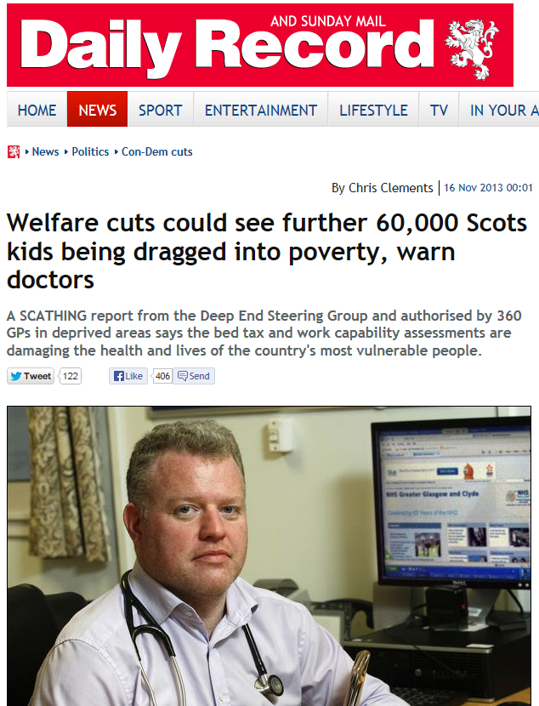
ADVOCACY
DEEP END REPORTS 16, 21, 25 and 27

Slide 10
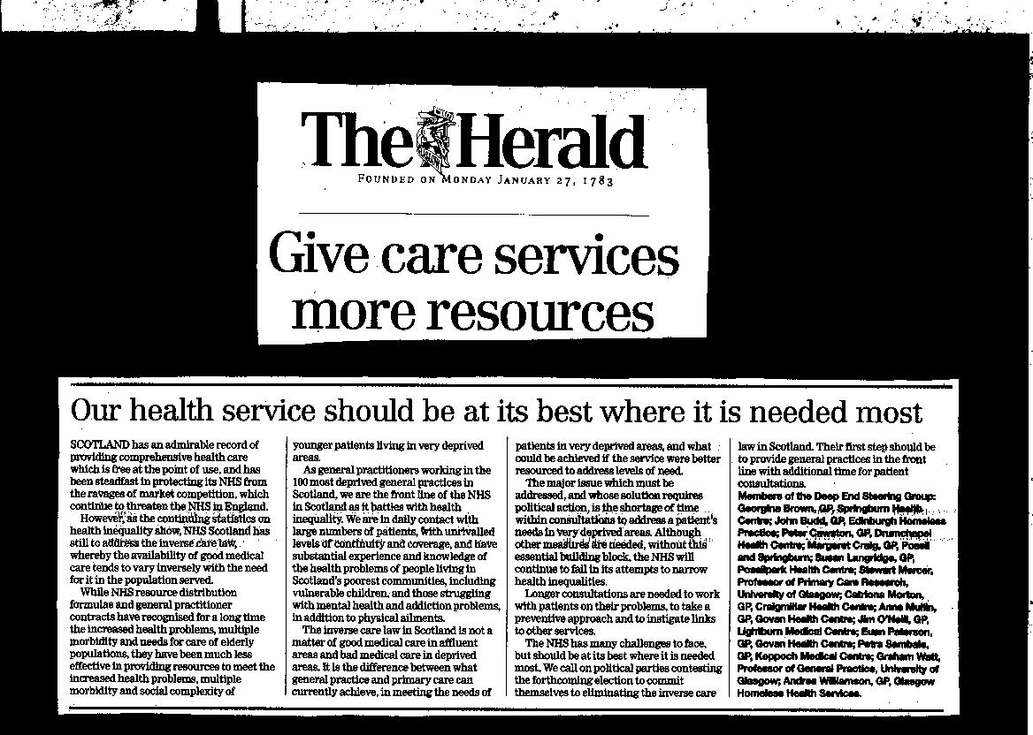


Slide 11
THE DEEP END MANIFESTO
Extra TIME for consultations (INVERSE CARE LAW)
Best use of serial ENCOUNTERS (PATIENT STORIES)
General practices as the NATURAL HUBS
of local health systems (LINKING WITH OTHERS)
4. Better CONNECTIONS across the front line (SHARED LEARNING)
5. Better SUPPORT for the front line (INFRASTRUCTURE)
6. LEADERSHIP at different levels (AT EVERY LEVEL)

Slide 12
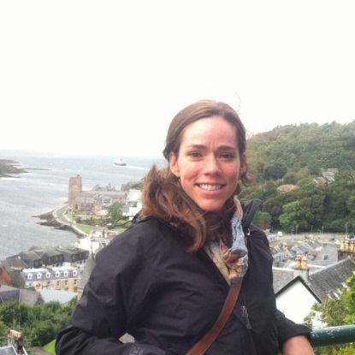
HOW DO
DEEP END
GENERAL
PRACTITIONERS
SEE THER ROLE ?
GP Scope
Politics
Policy
Community
Individual Social Issues
Individual Clinical
Care
BASED ON 24 INTERVIEWS WITH DEEP END GPS
BY BREANNON BABBEL, PHD STUDENT
Politics
Politics
Politics
Politics
Policy
Policy
Policy
Policy
Community
Community
Community
Community
Individual Social Issues
Individual Social Issues
Individual Social Issues
Individual Social Issues
Individual Clinical
Care
Individual Clinical
Care
Individual Clinical
Care
Individual Clinical
Care

Slide 13
ADVOCACY
not only what you say
but also, what you do

Slide 14

THE CARE PLUS STUDY
RCT of longer consultations for selected complex patients
CARE Plus prevents decline in QOL
Cost-effective (< £13,000 per QALY; NICE threshold is £20,000)
Mercer, S. W. et al. (2016) The Care Plus study – a whole system intervention to improve quality of life of primary care patents with multimorbidity in areas of high socio-economic deprivation :exploratory cluster randomised controlled trial and cost utility analysis. BMC Medicine, 14, 88. (doi:10.1186/s12916-016-0634-2)

Slide 15

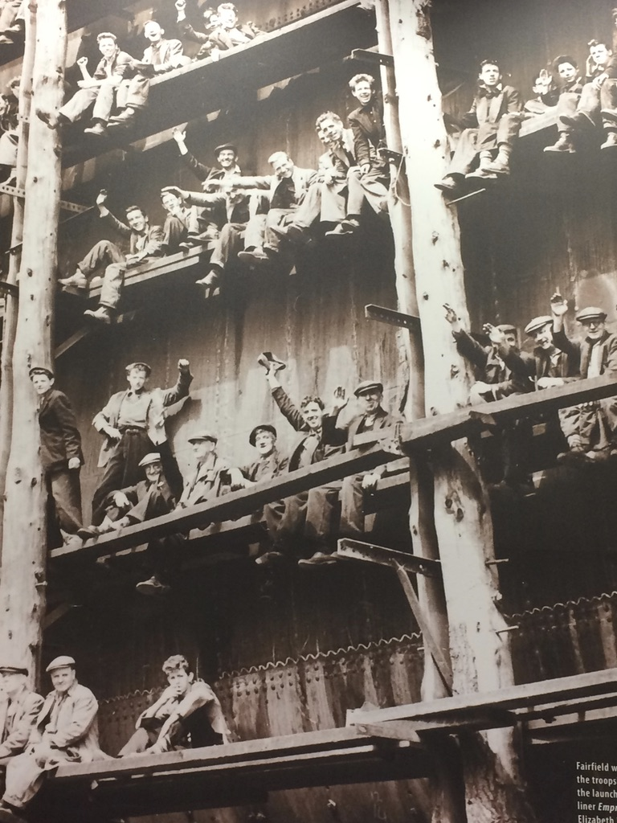
GOVAN SHIP
(Social Health Integration Partnershipp)
4 general practices in one health centre
Added clinical capacity (via long term GP locums)
Protected time for extended consultations
Monthly Multidisciplinary Team (MDT) Meetings
Attached social care workers
Administrative support
Targeting 8% of patients reduced practice workload overall

Slide 16
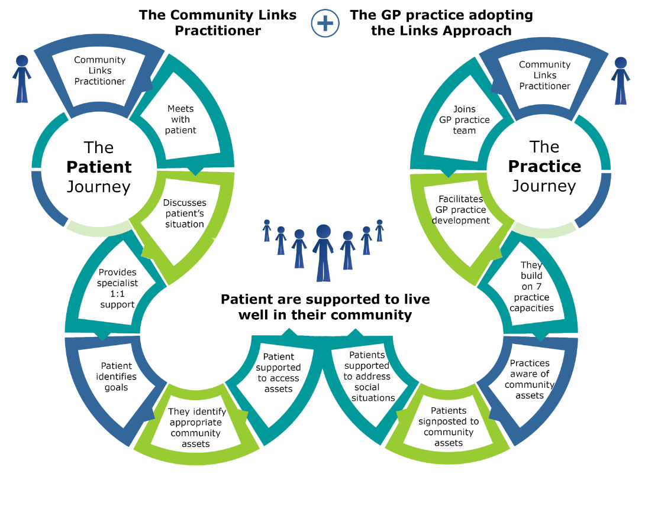


THE COMMUNITY LINK WORKER PROGRAMME

Slide 17
THE PARKHEAD FINANCIAL ADVICE PROJECT
Engagement of practice
Increase in new referrals, made mostly by GPs
65% uptake
Median financial benefit per claimant of £7,000 per annum
68% of people engaging with the service stated they had a mental health condition
About a half of people were referred to additional forms of community support
More time for GPs to address clinical problems
Now being rolled out to 150 other local practices

Slide 18
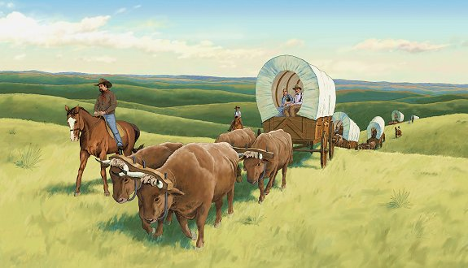
THE DEEP END GP PIONEER SCHEME
Additional capacity via GP fellows
Protected time for host GPs (as in SHIP)
Shared learning based on service developments
Day release scheme for GP fellows
Recording of shared activity via website

Slide 19
ACTIVE INGREDIENTS OF THE SCOTTISH DEEP END PROJECT
Additional capacity
Leadership at a local level
GP protected sessions
Extended consultations for selected patients
Bottom-up integrated care via multidisciplinary team meetings
Embedded community link practitioners acting as generalists
Embedded financial advisors
Associated evaluation and research
Shared learning between practices
Advocacy
Involvement of the next generation of GPs

Slide 20
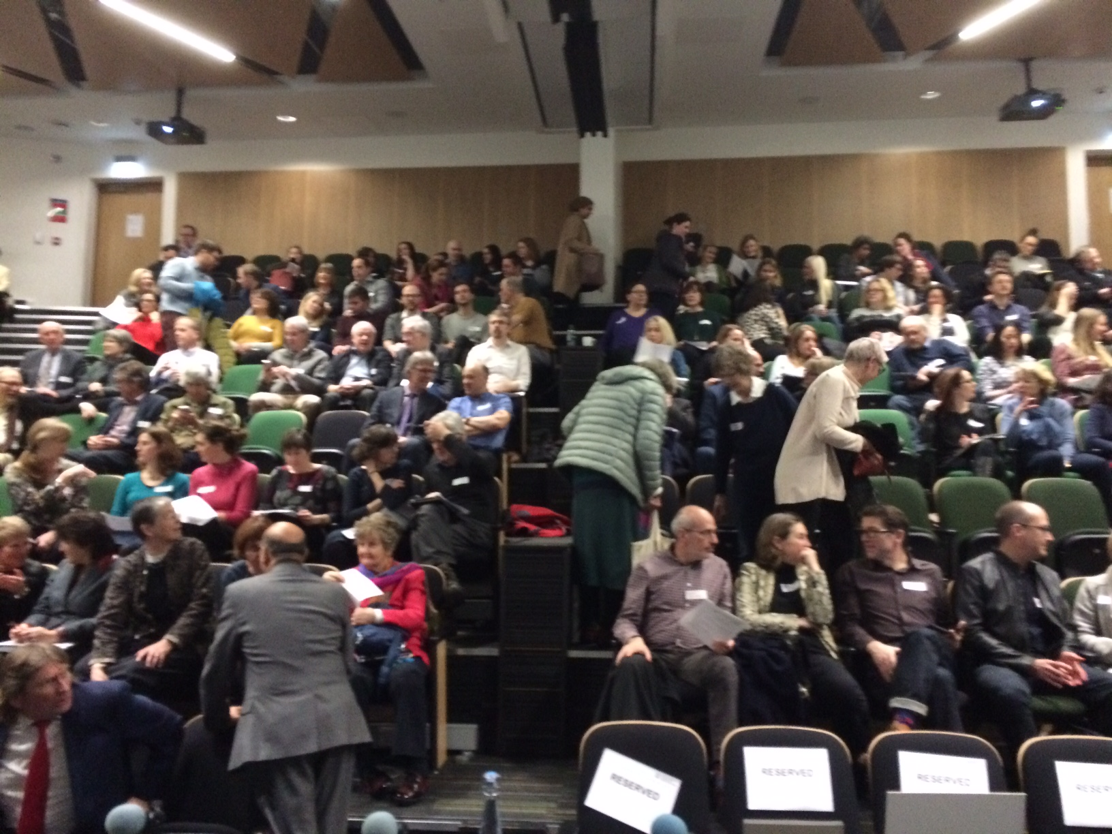
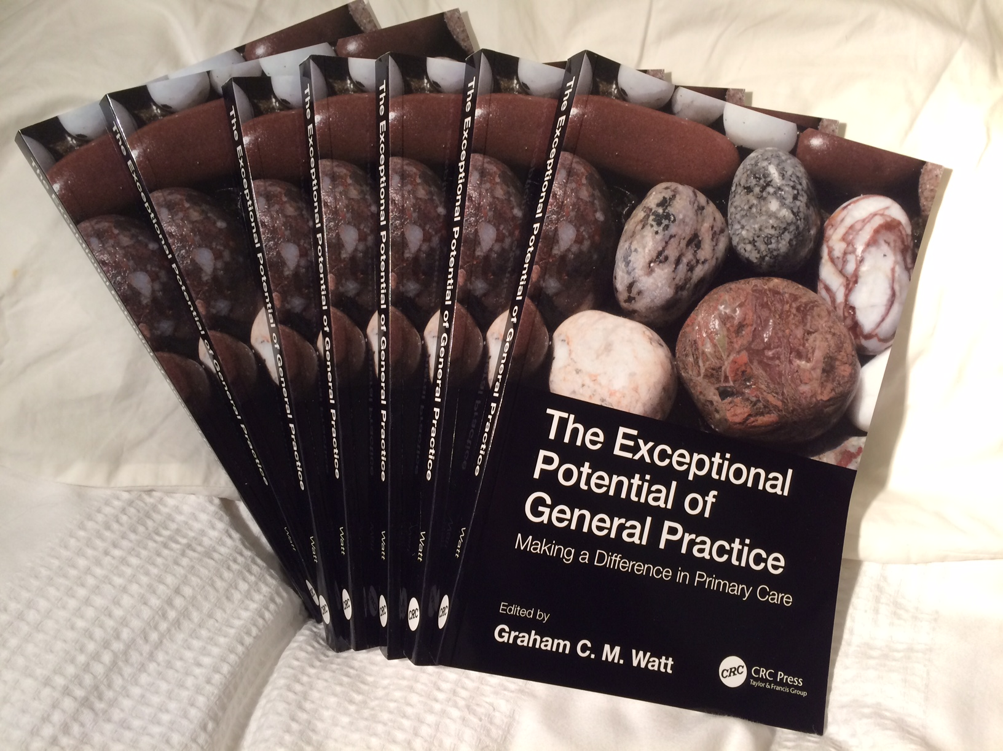
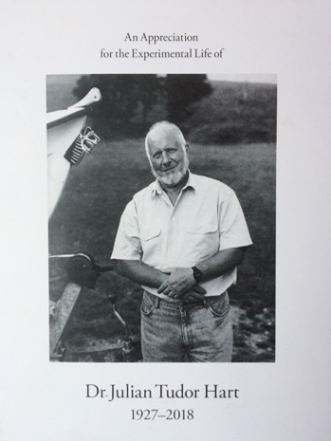
Conference
THE EXCEPTIONAL POTENTIAL OF GENERAL PRACTICE
Making a difference in Primary Care
14-15th February 2019, Glasgow

Slide 21
YES, this is what I do
YES, that’s what I want to be part of
YES, that’s the direction I want to go

Slide 22
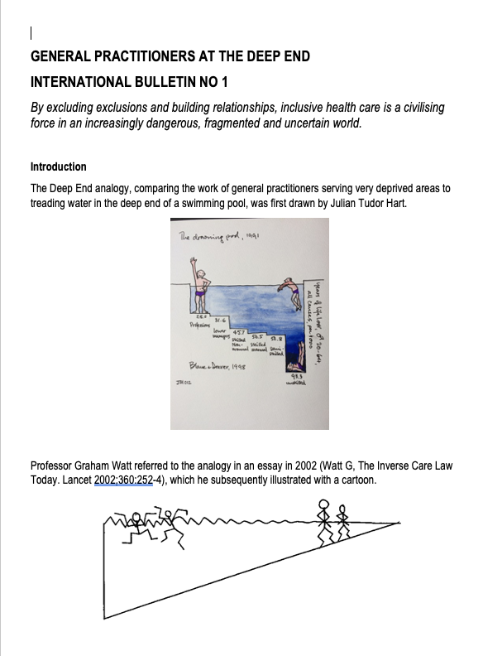
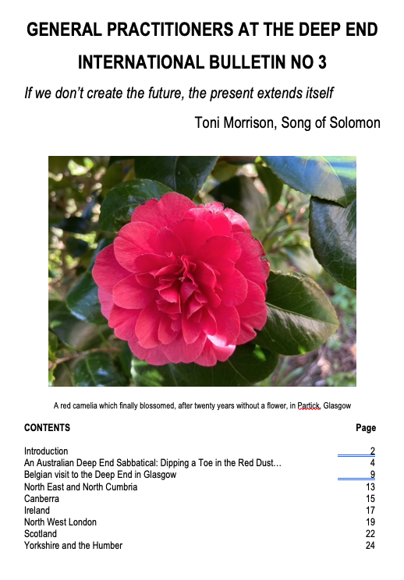
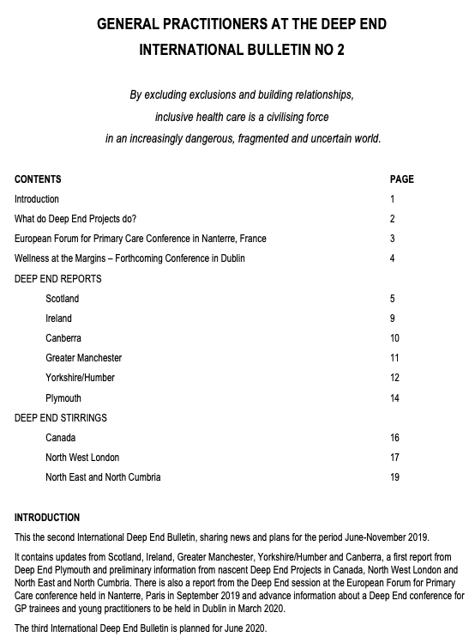

DEEP END INTERNATIONAL BULLETING NOS 1-4
News from :
Scotland
Ireland
Yorkshire/Humber
Greater Manchester
Canberra, Australia
Plymouth
NW London
North-East and North Cumbria
Nottinghamshire
www.gla.ac.uk/deepend

Slide 23

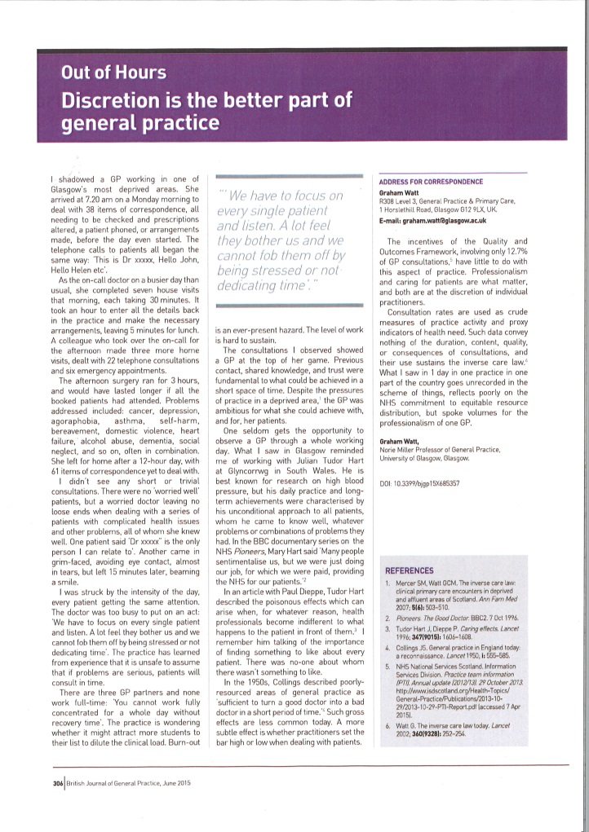
A DAY IN THE LIFE …….
Ubiquitous, endemic complexity
The value of previous encounters
Empathy and trust
A “worried doctor”
Setting the bar high
Every patient matters
BJGP, June 2015

Slide 24
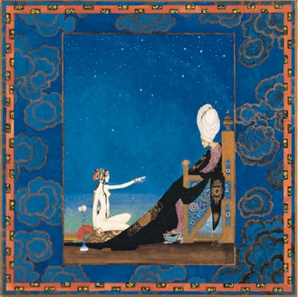
SHEHEREZADE
TELLING 1001 TALES

Slide 25
Building
KNOWLEDGE
CONFIDENCE
AGENCY

Slide 26
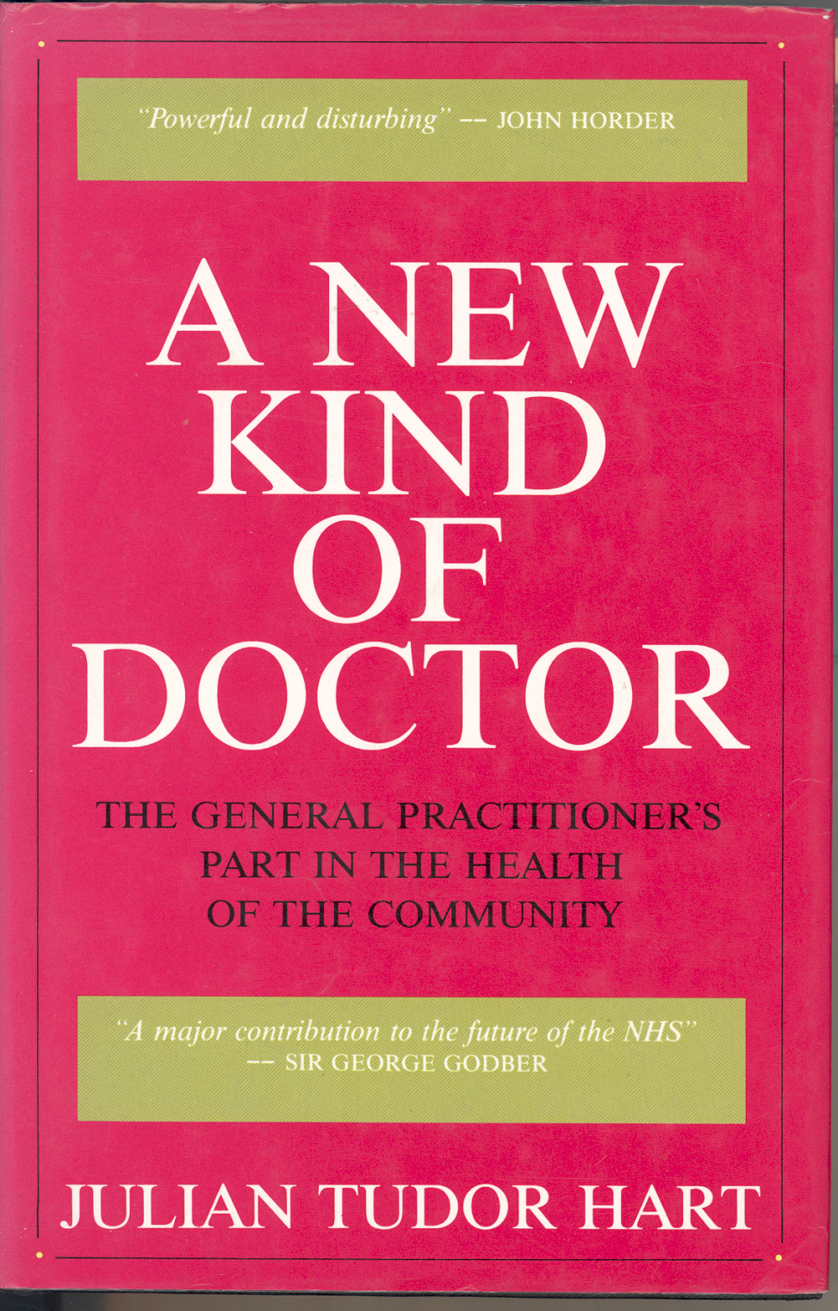
RELATIONSHIPS WITH PATIENTS
“Initially face to face, eventually side by side”
Julian Tudor Hart
A NEW KIND OF DOCTOR

Slide 27
10% of patients with 4 or more conditions accounted for
34% of patients with unplanned admissions to hospital and
47% of patients with potentially preventable unplanned admissions
Payne R, Abel G, Guthrie B, Mercer SW. The impact of physical multimorbidity, mental health conditions
and socioeconomic deprivation on unplanned admissions to hospital: a retrospective cohort study.
CMAJ 185 (e-publication ahead of print): E221-E228, 2013, doi:10.1503/cmaj.121349

Slide 28
RELATIONSHIPS
ARE THE
SILVER BULLETS
OF GENERAL PRACTICE AND PRIMARY CARE
Especially for the 15% of patients who account for 50% of the workload

Slide 29

INTRINSIC FEATURES OF GENERAL PRACTICE
Contact
Coverage
Continuity
Coordination
Flexibility
Relationships
Trust

Slide 30
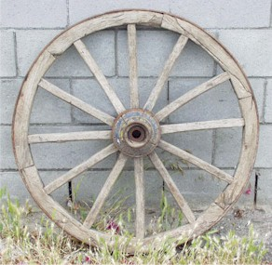
INVENTING THE WHEEL
HUB
Contact
Coverage
Continuity
Comprehensive
Coordinated
Flexibility
Relationships
Trust
Leadership
SPOKES + RIMS
Keep Well
Child Health
Elderly
Mental Health
Addictions
Community Care
Secondary Care
Voluntary sector
Local Communities
INTEGRATED CARE DEPENDS ON MULTIPLE RELATIONSHIPS

Slide 31
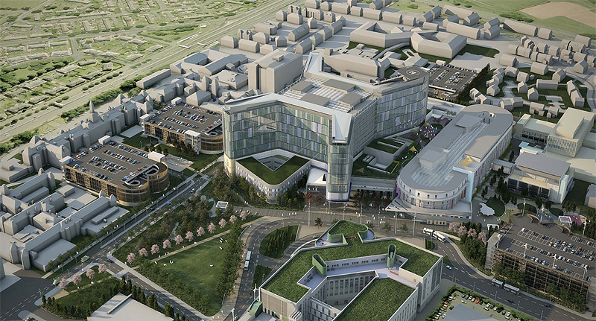

PRACTICE-BASED BUILDING PROGRAMMES
A COMPENDIUM OF PATIENT STORIES
STRONG LOCAL HEALTH SYSTEMS

Slide 33
BUILDING PROGRAMMES
A COMPENDIUM OF PATIENT STORIES
STRONG LOCAL HEALTH SYSTEMS
NETWORKS OF LOCAL SYSTEMS

Slide 34
POLITICAL AND CENTRAL SUPPPORT NEEDED FOR …..
Resources commensurate with need
Information systems to measure omissions and monitor progress
Educational opportunities to share learning
Research and Evaluation to establish what works
Career opportunities to attract, sustain and retain practitioners

Slide 35
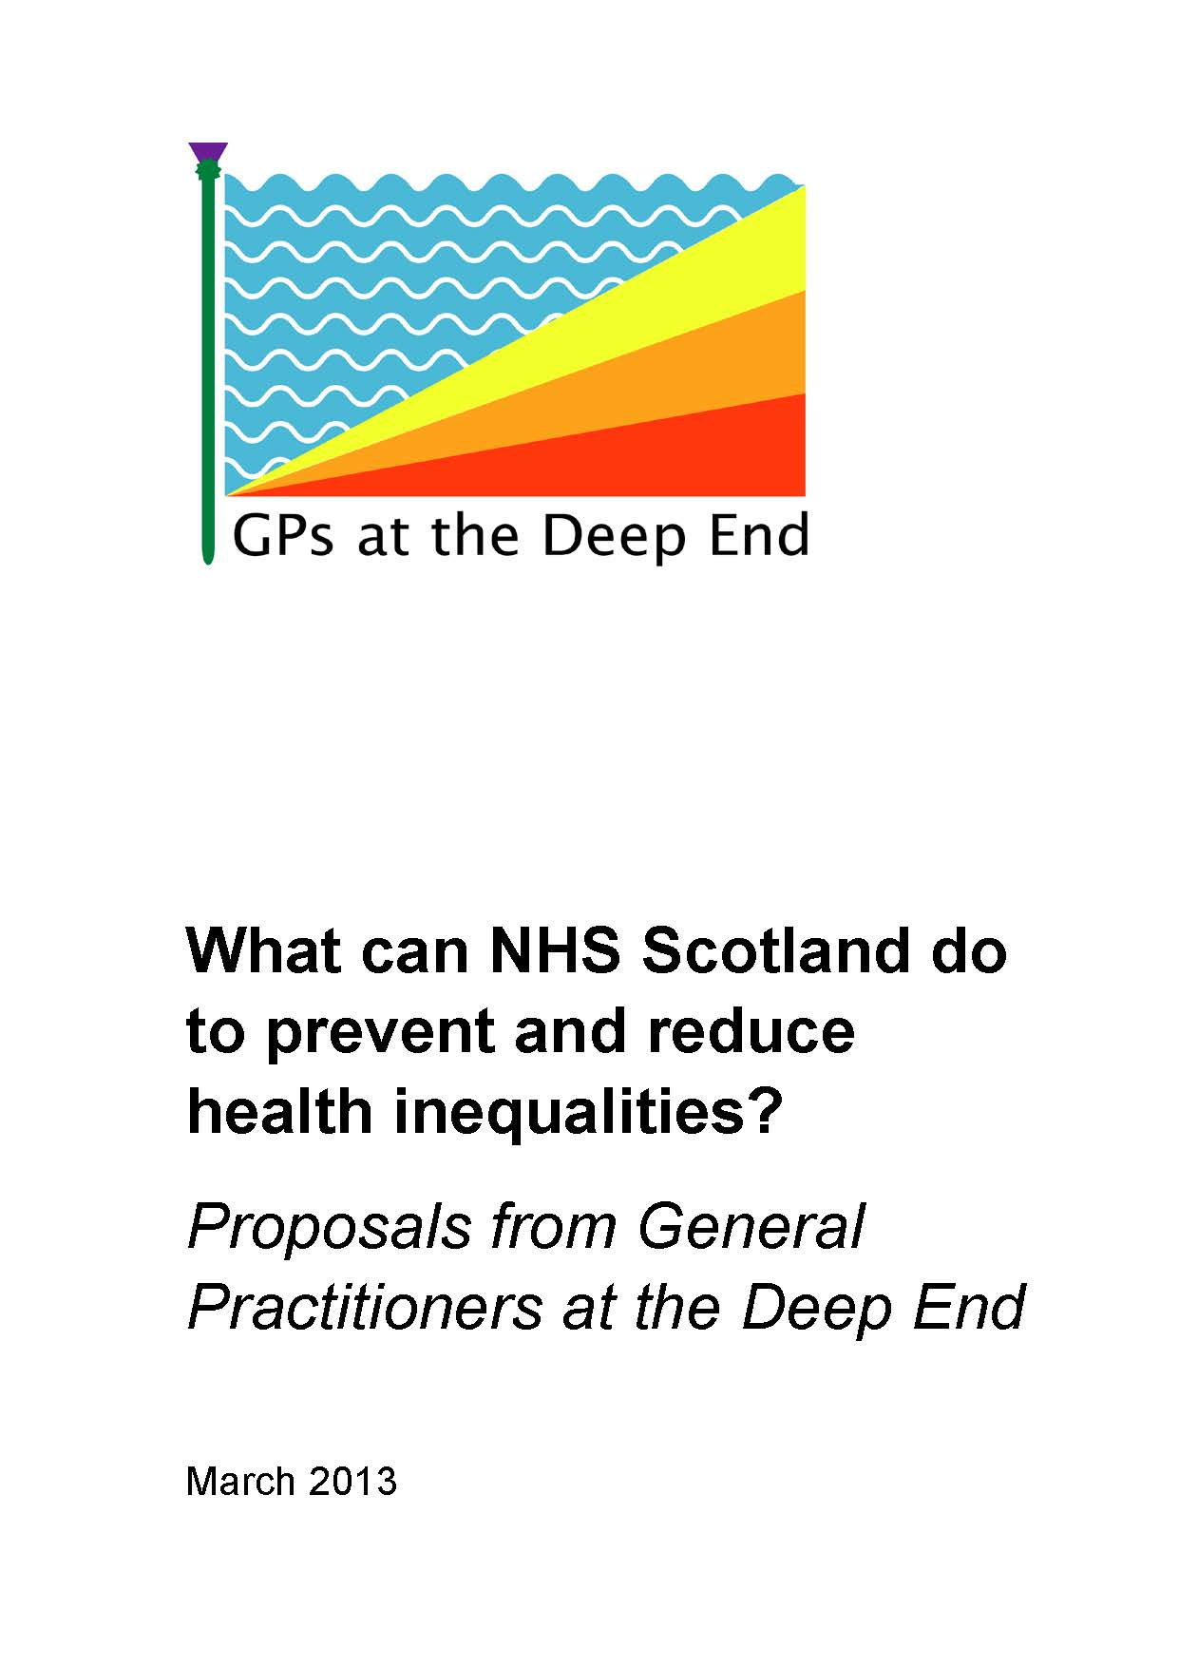

Slide 36

PREVENTING AND POSTPONING CRISES
FOR EMERGENCY CARE THERE IS NO GATE
ONLY A GATEWAY
(that patients can go through at any time)

Slide 37
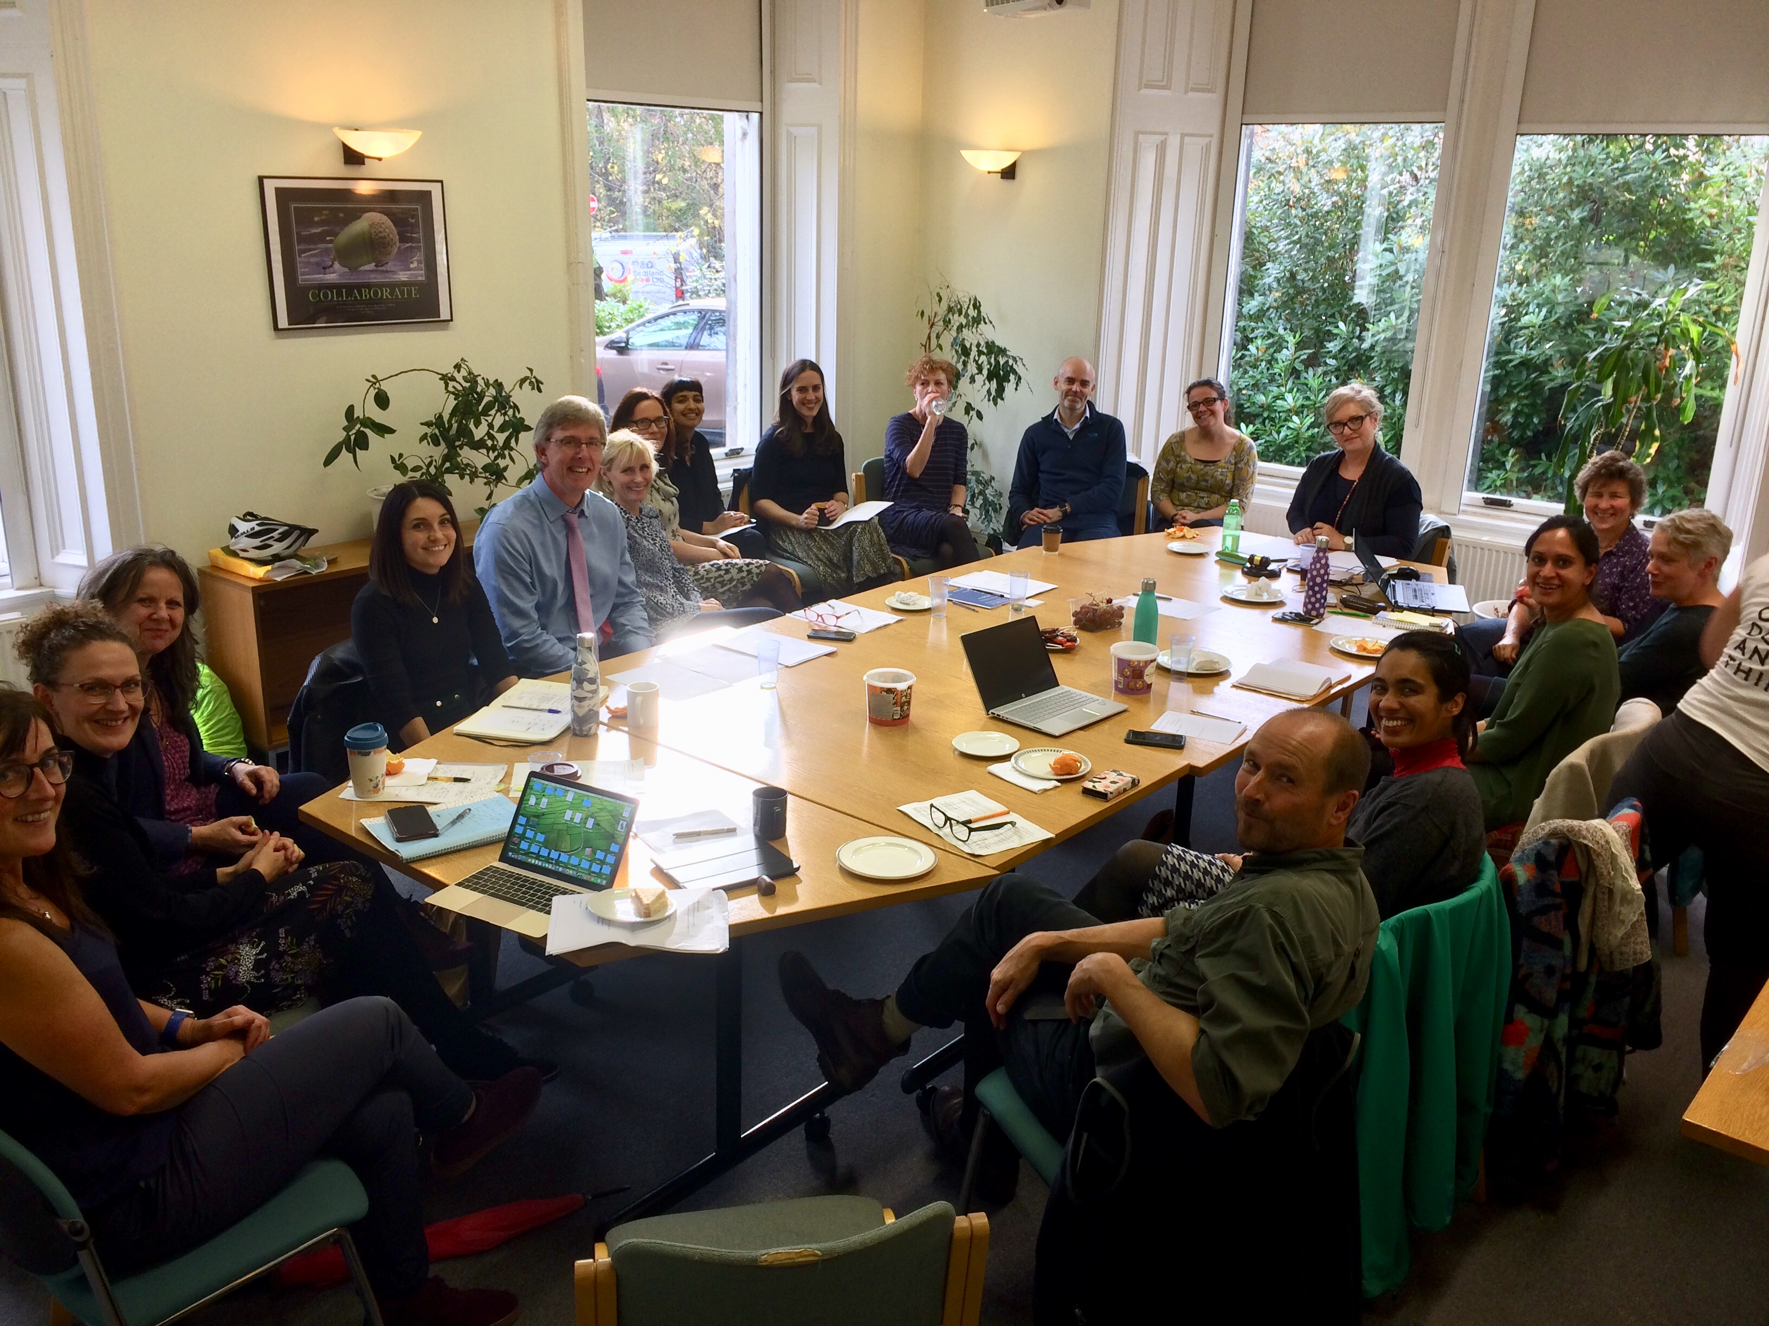

Slide 38
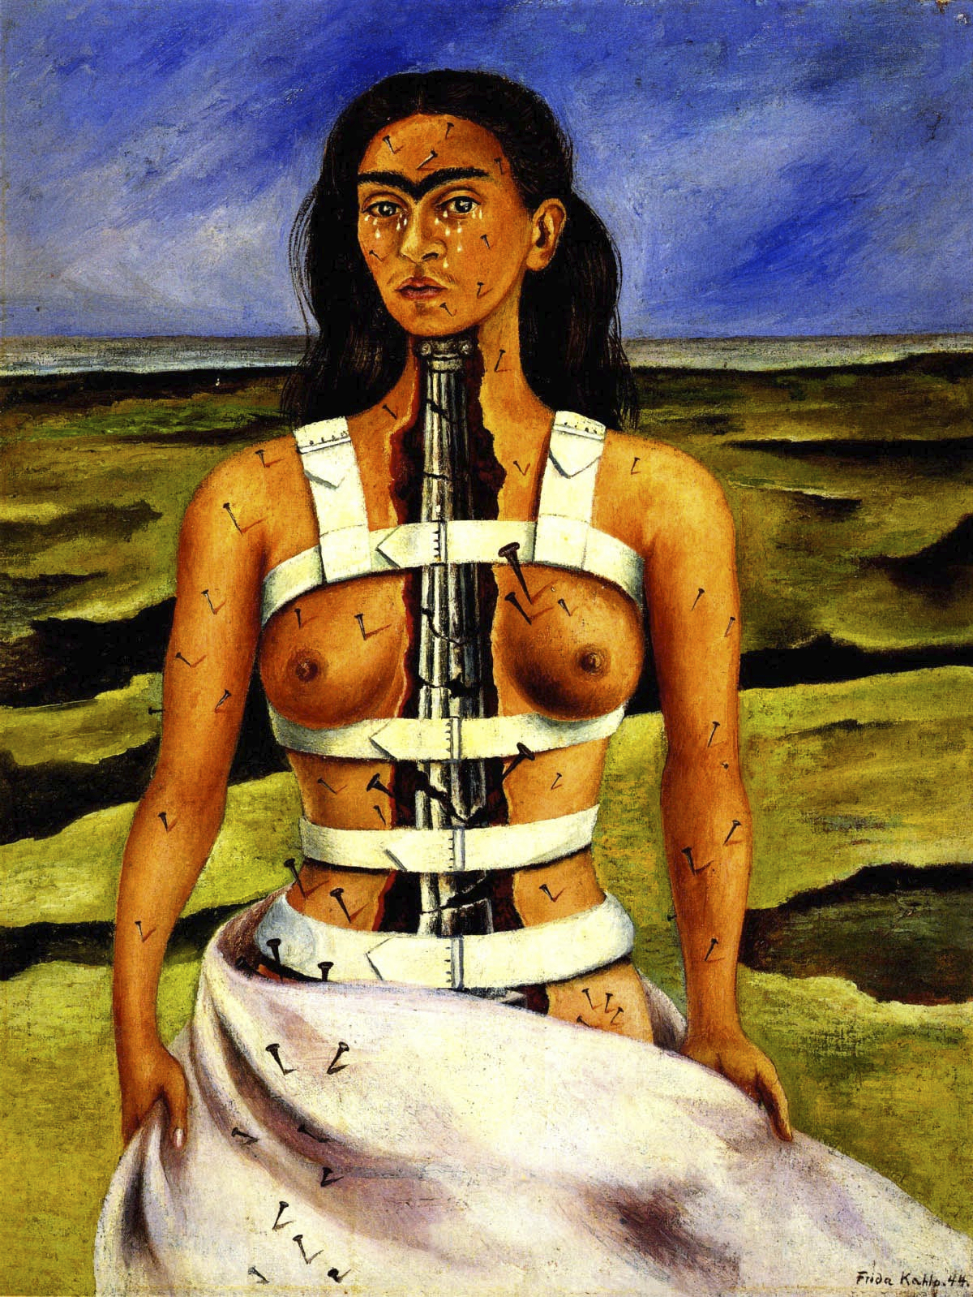
…in the dark age in which we are living
and the new world order,
the sharing of pain is one of the essential preconditions
for a re-finding of dignity and hope.
Much pain is unshareable.
but the will to share pain is shareable
and from that inevitably inadequate sharing
comes a resistance.
John Berger

Slide 39
“By excluding exclusions,
keeping everyone on board,
and building three types of relationship,
inclusive health care can be a civilizing force
in this increasingly dangerous, fragmented and uncertain world.”
The Exceptional and Equitable Potential of General Practice

